Slide 1
Listen to Chapters 3 & 4
George Begins to Make the Medicine
Animal Pills
Copies of the Chapter 3 & 4.

Slide 2
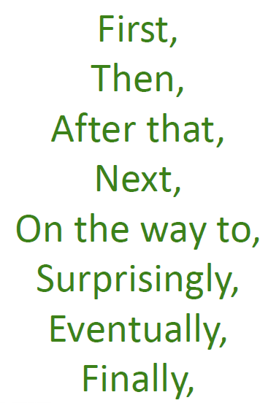
Can you plot where George goes to find his medicine?
Use a variety of different of openers for each location.
First, George goes in to the bathroom.

Slide 3
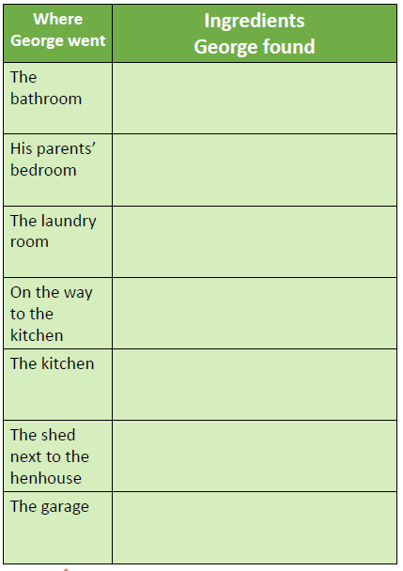
You may need to skim or scan the text. (Which means you don’t need to read it in full but look for key words.)
Now I would like you to write full sentences describing where George went and what he found there.
**Remember commas for lists.**

