Slide 1
Pablo Picasso
This term we are learning about the artist Pablo Picasso, we will be creating pictures and models in his style.

Slide 2
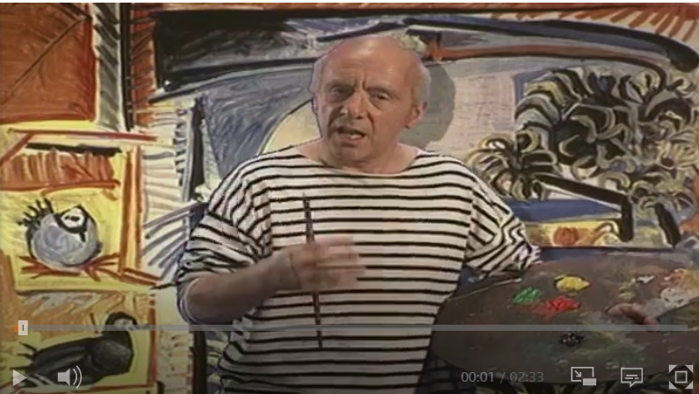
Firstly let’s learn about the artist. Take some notes during the clip and create a fact file on Pablo.

Slide 3
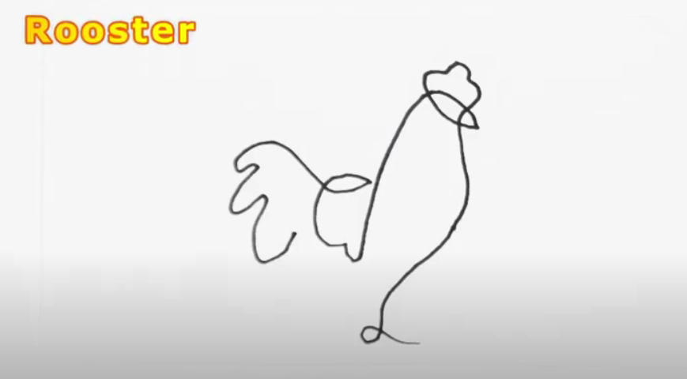
Single Line Drawing
The next video shows you some single line drawings, watch and then try some of the ones shown.
Next I would like you to pick an image either one from the video or your own and create a final single line drawing.
Keep it safe because we will need it later.
Remember you pencil can’t come off the paper until you have completed your picture.

