Slide 1
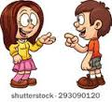
Active
and passive verbs
What was said just now?

Slide 2
Subject and object (revision)
What is the subject of each of these sentences?
The dog barked.
The dog bit me.
I bit the dog.
You must get off the bus.
This bus goes to Leeds.
I am a dog.
The dog barked.
The dog bit me.
I bit the dog.
You must get off the bus.
This bus goes to Leeds.
I am a dog.

Slide 3
Subject and object (revision)
What is the object of each of these sentences? Do they all have an object?
The dog barked.
The dog bit me.
I bit the dog.
You must go to Leeds on the bus.
I’m sharpening my pencil.
Get a new pencil.
The dog barked.
The dog bit me.
I bit the dog.
You must go to Leeds on the bus.
I’m sharpening my pencil.
Get a new pencil.

Slide 4
Discuss with a partner:
Every sentence must have a subject.
True or false?
If you think it’s false, give an example of a correctly formed sentence which has no subject.
Example(s) here

Slide 5
Discuss with a partner:
Every sentence must have an object.
True or false?
If you think it’s false, give an example of a correctly formed sentence which has no object.
Example(s) here

Slide 6
All in order…
object - subject - verb :
What is their usual order in an English sentence?
Subject
Verb
Object

Slide 7
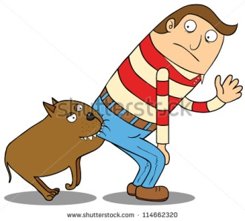
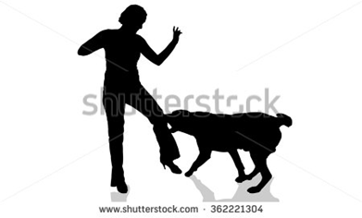
Passive verbs
A passive verb lets us use the object of the action as the subject of the sentence.
The dog bit me. (active verb)
I was bitten by the dog. (passive verb)

Slide 8
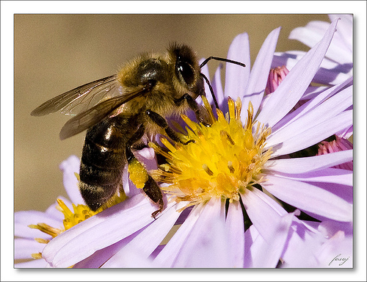
Turn these active verb sentences into passive verb sentences:
Bees make honey.
Honey is …
The sun
warmed and
dried him.
A passing herd of buffalo nearly flattened us.
A projecting ledge of rock broke my fall.
Honey is made by bees.
He was warmed and dried by the sun.
We were nearly flattened by a passing herd of buffalo.
My fall was broken by a projecting ledge of rock.

Slide 9
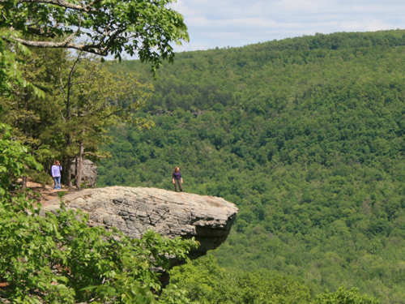
Turn these passive verb sentences into active verb sentences:
My fall was broken by a
projecting
ledge of rock.
The robbers
were seen by
a member
of the public.
A projecting ledge of rock broke my fall.
A member of the public saw the robbers.

Slide 10
Grammar nerds’ corner
Passive verbs can be in any tense: past, present, future and so on.
That’s why it is not called the passive “tense” but the passive voice of the verb.
Examples: It amuses me – present tense, active voice.
I am amused – present tense, passive voice.
I was amused – past tense, passive voice.

Slide 11
Identify the tense and voice of the verbs in these sentences:
I missed the bus yesterday.
John will be asked to leave.
My hamster eats too much.
My hamster was eaten by the cat.
My ears were assailed by a howling noise.
The dog was howling.

Slide 12
Now create your own sentence using:
Present tense, active voice
Past tense, passive voice
Past tense, active voice
Future tense, active voice
Present tense, passive voice
Future tense, passive voice

Slide 13
Sentences with two objects
Find the subject, verb and object of this sentence:
My granny gave me a new game for my birthday.
My granny gave me a new game for my birthday.
What is the object: “me” or “a new game”?
How do we make this sentence passive?

Slide 14
Sentences with two objects
My granny gave me a new game for my birthday.
How do we make this sentence passive?
There are two ways because there are two objects.
“A new game” is called the direct object – it’s the thing that was given.
“Me” is called the indirect object – you are the person it was given to.
So we can say:

Slide 15
Sentences with two objects
A new game was given to me by my granny.
Or: I was given a new game by my granny.
Which one do you think sounds better?
Now turn these into passive verb sentences:
The head teacher awarded Abbie a prize.
Adult birds bring food to their chicks. (Careful
with this one! You may need to change things a little to make
it sound good.)

Slide 16
Style tips: (1) Don’t overdo it!
What is this writer trying to say?
It is noted that your vehicle has been reported to have been parked improperly and you have consequently been issued with a penalty of £40 which must be paid in full within 30 days.
In plain English, this writer is saying four things:
1. You parked in the wrong place.
2. We are fining you £40.
3. Please pay within 30 days.
4. I am a pompous bureaucrat.

Slide 17
Style tips: (2) Use “be”, not “get”
In spoken
English, you
can hear
people
saying
things like:
“We got nicked,” or “That’s how these things get done.”
That’s OK in informal speech – but don’t use it in your writing, except in dialogue.
In standard written English, we use the auxiliary verb (helping verb) “to be” to form the passive voice.
Not “to get”.

Slide 18
Rewrite these sentences, using the correct form of the passive voice for standard written English:
I got stung by a wasp.
Plants get pollinated by insects.
Proteins get broken down by enzymes in our guts.
Trespassers will get prosecuted.

Slide 19
Passive verb forms
What have we learned?
Tell your partner two things you now know about passive verbs.
Listening skills:
Be prepared to share with the class what your partner said to you.

